Slide 1
Communications

Slide 2
Who Needs Communications?
The need for communications between tasks depends upon your problem:
You DON'T need communications
Some types of problems can be decomposed and executed in parallel with virtually no need for tasks to share data. These types of problems are often called embarrassingly parallel - little or no communications are required.
For example, imagine an image processing operation where every pixel in a black and white image needs to have its color reversed.
The image data can easily be distributed to multiple tasks that then act independently of each other to do their portion of the work.

Slide 3
Who Needs Communications?
The need for communications between tasks depends upon your problem:
You DON'T need communications
Some types of problems can be decomposed and executed in parallel with virtually no need for tasks to share data. These types of problems are often called embarrassingly parallel - little or no communications are required.
For example, imagine an image processing operation where every pixel in a black and white image needs to have its color reversed.
The image data can easily be distributed to multiple tasks that then act independently of each other to do their portion of the work.

Slide 4
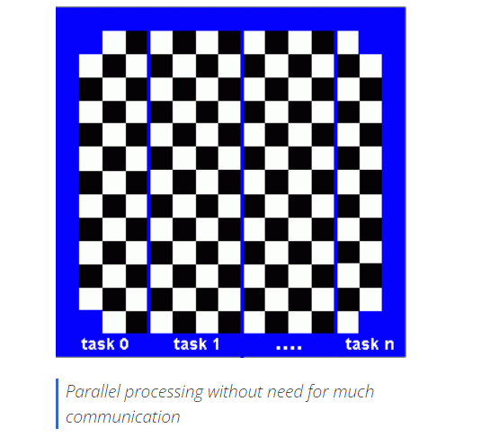

Slide 5
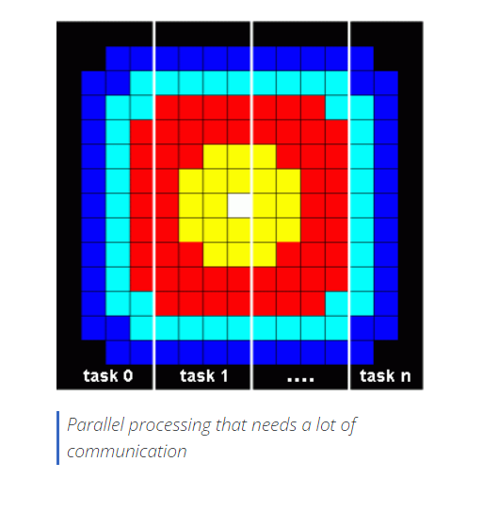
You DO need communications
Most parallel applications are not quite so simple, and do require tasks to share data with each other.
For example, a 2-D heat diffusion problem requires a task to know the temperatures calculated by the tasks that have neighboring data. Changes to neighboring data has a direct effect on that task's data.

Slide 6
Factors to Consider when designing your program's inter-task communications:
Communication overhead
Inter-task communication virtually always implies overhead.
Machine cycles and resources that could be used for computation are instead used to package and transmit data.
Communications frequently require some type of synchronization between tasks, which can result in tasks spending time "waiting" instead of doing work.
Competing communication traffic can saturate the available network bandwidth, further aggravating performance problems.

Slide 7
Latency vs. bandwidth
Latency is the time it takes to send a minimal (0 byte) message from point A to point B. Commonly expressed as microseconds.
Bandwidth is the amount of data that can be communicated per unit of time. Commonly expressed as megabytes/sec or gigabytes/sec.
Sending many small messages can cause latency to dominate communication overheads. Often it is more efficient to package small messages into a larger message, thus increasing the effective communications bandwidth.

Slide 8
Visibility of communications
With the Message Passing Model, communications are explicit and generally quite visible and under the control of the programmer.
With the Data Parallel Model, communications often occur transparently to the programmer, particularly on distributed memory architectures.
The programmer may not even be able to know exactly how inter-task communications are being accomplished.

Slide 9
Synchronous vs. asynchronous communications
Synchronous communications require some type of "handshaking" between tasks that are sharing data. This can be explicitly structured in code by the programmer, or it may happen at a lower level unknown to the programmer.
Synchronous communications are often referred to as blocking communications since other work must wait until the communications have completed.
Asynchronous communications allow tasks to transfer data independently from one another. For example, task 1 can prepare and send a message to task 2, and then immediately begin doing other work. When task 2 actually receives the data doesn't matter.
Asynchronous communications are often referred to as non-blocking communications since other work can be done while the communications are taking place.
Interleaving computation with communication is the single greatest benefit for using asynchronous communications.

Slide 10
Scope of communications
Knowing which tasks must communicate with each other is critical during the design stage of a parallel code. Both of the two scoping described below can be implemented synchronously or asynchronously.
Point-to-point - involves two tasks with one task acting as the sender/producer of data, and the other acting as the receiver/consumer.
Collective - involves data sharing between more than two tasks, which are often specified as being members in a common group, or collective. Some common variations (there are more):

Slide 11
Scope of communications
Knowing which tasks must communicate with each other is critical during the design stage of a parallel code. Both of the two scoping described below can be implemented synchronously or asynchronously.
Point-to-point - involves two tasks with one task acting as the sender/producer of data, and the other acting as the receiver/consumer.
Collective - involves data sharing between more than two tasks, which are often specified as being members in a common group, or collective. Some common variations (there are more):

Slide 12
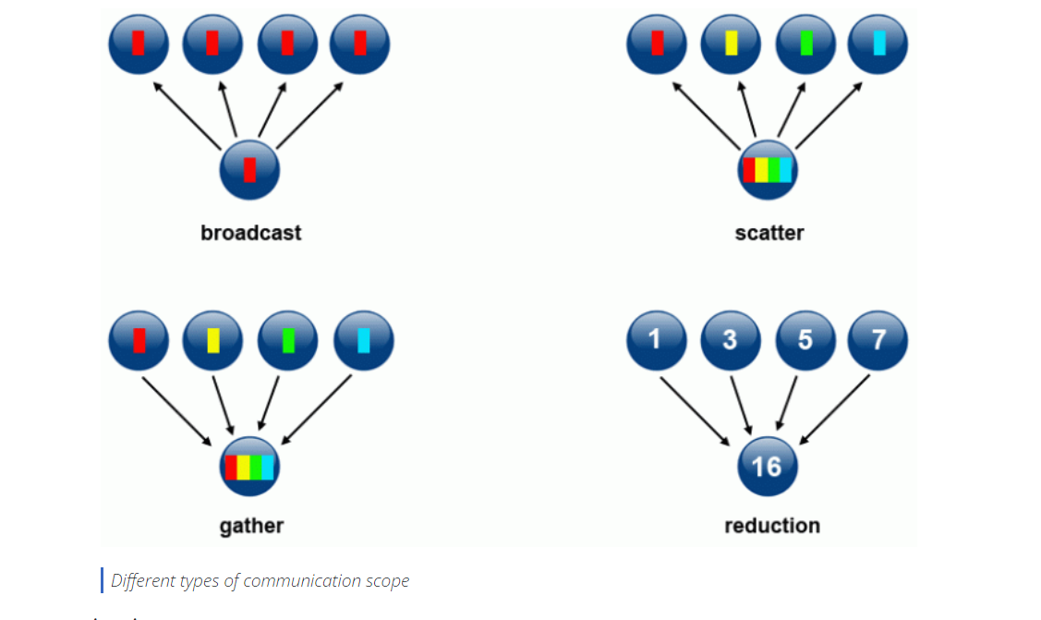

Slide 13
Efficiency of communications
Oftentimes, the programmer has choices that can affect communications performance. Only a few are mentioned here.
Which implementation for a given model should be used? Using the Message Passing Model as an example, one MPI implementation may be faster on a given hardware platform than another.
What type of communication operations should be used? As mentioned previously, asynchronous communication operations can improve overall program performance.
Network fabric—different platforms use different networks. Some networks perform better than others. Choosing a platform with a faster network may be an option.

Slide 14
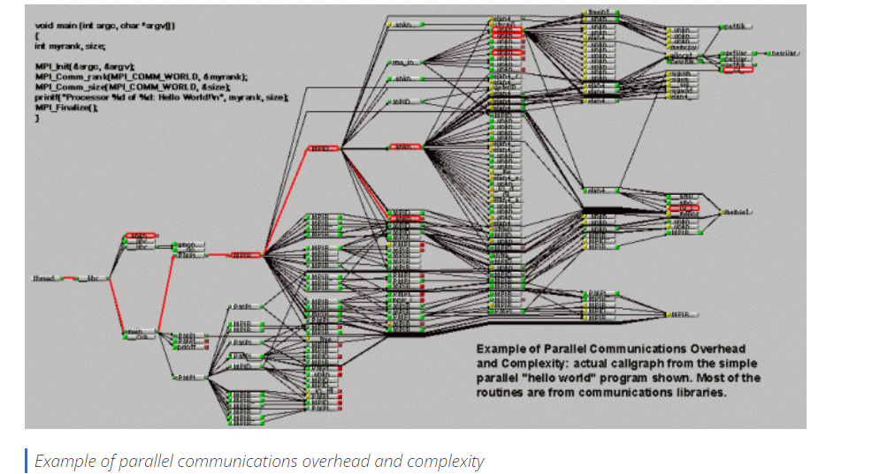
Overhead and complexity

Slide 15
Synchronization

Slide 16
Synchronization
Managing the sequence of work and the tasks performing it is a critical design consideration for most parallel programs.
Can be a significant factor in program performance (or lack of it)
Often requires "serialization" of segments of the program.

Slide 17
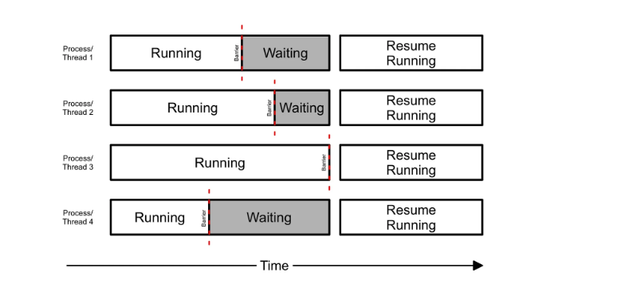
Types of Synchronization
Barrier
Barrier synchronization is a technique used in computer programming to ensure that multiple threads reach a specific point of execution before continuing
Usually implies that all tasks are involved
Each task performs its work until it reaches the barrier. It then stops, or "blocks".
When the last task reaches the barrier, all tasks are synchronized.
What happens from here varies. Often, a serial section of work must be done. In other cases, the tasks are automatically released to continue their work.

Slide 18
Lock / semaphore
Can involve any number of tasks
Typically used to serialize (protect) access to global data or a section of code. Only one task at a time may use (own) the lock / semaphore / flag.
The first task to acquire the lock "sets" it. This task can then safely (serially) access the protected data or code.
Other tasks can attempt to acquire the lock but must wait until the task that owns the lock releases it.
Can be blocking or non-blocking.

Slide 19
Synchronous communication operations
Involves only those tasks executing a communication operation.
When a task performs a communication operation, some form of coordination is required with the other task(s) participating in the communication.
For example, before a task can perform a send operation, it must first receive an acknowledgment from the receiving task that it is OK to send.

Slide 20
Data Dependencies

Slide 21
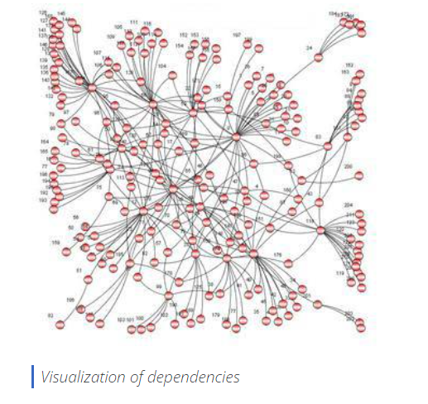
Data Dependencies
A dependence exists between program statements when the order of statement execution affects the results of the program.
A data dependence results from multiple use of the same location(s) in storage by different tasks.
Dependencies are important to parallel programming because they are one of the primary inhibitors to parallelism.

Slide 22
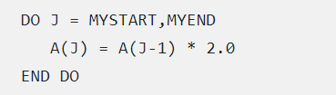
Examples
The value of A(J-1) must be computed before the value of A(J), therefore A(J) exhibits a data dependency on A(J-1). Parallelism is inhibited.
If Task 2 has A(J) and task 1 has A(J-1), computing the correct value of A(J) necessitates:
  Distributed memory architecture - task 2 must obtain the value of A(J-1) from task 1 after task 1 finishes its computation
  Shared memory architecture - task 2 must read A(J-1) after task 1 updates it

Slide 23
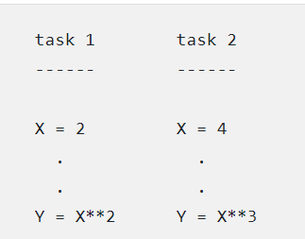
Loop independent data dependence
As with the previous example, parallelism is inhibited. The value of Y is dependent on:
  Distributed memory architecture - if or when the value of X is communicated between the tasks.
  Shared memory architecture - which task last stores the value of X.
Although all data dependencies are important to identify when designing parallel programs, loop carried dependencies are particularly important since loops are possibly the most common target of parallelization efforts.

Slide 24
How to Handle Data Dependencies
Distributed memory architectures - communicate required data at synchronization points.
Shared memory architectures -synchronize read/write operations between tasks.

Slide 25
Load Balancing

Slide 26
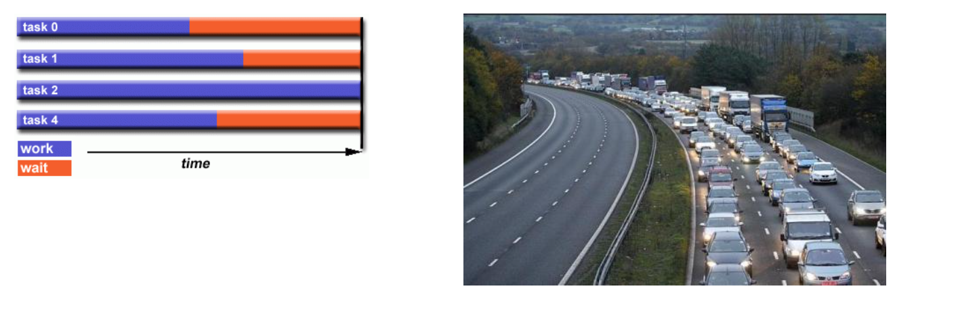
Load Balancing
Load balancing refers to the practice of distributing approximately equal amounts of work among tasks so that all tasks are kept busy all of the time.
It can be considered a minimization of task idle time.
Load balancing is important to parallel programs for performance reasons.
For example, if all tasks are subject to a barrier synchronization point, the slowest task will determine the overall performance.

Slide 27
How to Achieve Load Balance
Equally partition the work each task receives
For array/matrix operations where each task performs similar work, evenly distribute the data set among the tasks.
For loop iterations where the work done in each iteration is similar, evenly distribute the iterations across the tasks.
If a heterogeneous mix of machines with varying performance characteristics are being used, be sure to use some type of performance analysis tool to detect any load imbalances. Adjust work accordingly.

Slide 28
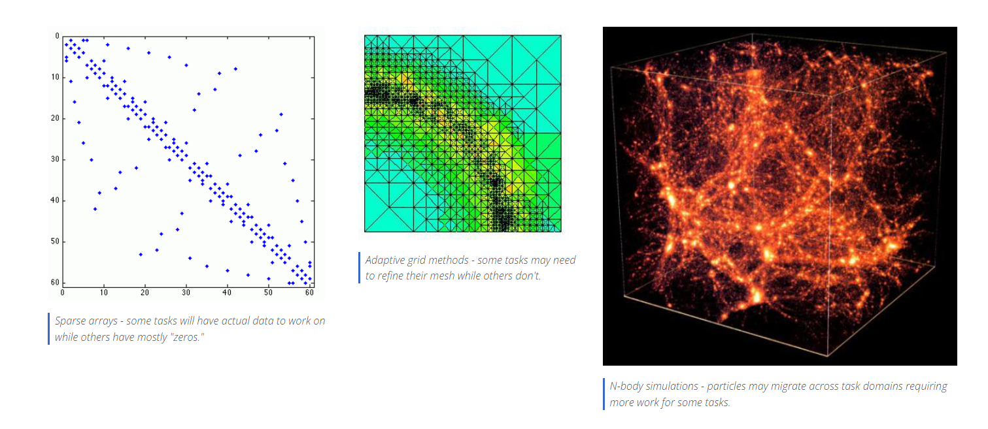
Use dynamic work assignment
Certain classes of problems result in load imbalances even if data is evenly distributed among tasks:
When the amount of work each task will perform is intentionally variable, or is unable to be predicted, it may be helpful to use a scheduler-task pool approach. As each task finishes its work, it receives a new piece from the work queue.

Slide 29
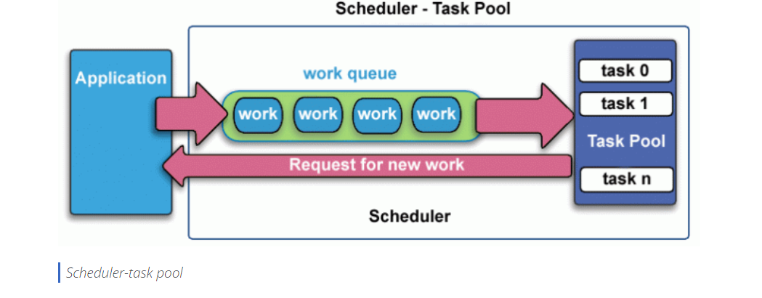
Ultimately, it may become necessary to design an algorithm which detects and handles load imbalances as they occur dynamically within the code.

Slide 30
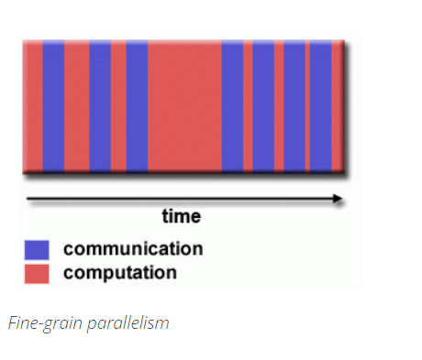
Granularity
Computation / Communication Ratio
In parallel computing, granularity is a qualitative measure of the ratio of computation to communication.
Periods of computation are typically separated from periods of communication by synchronization events.
Fine-grain Parallelism

Slide 31
Relatively small amounts of computational work are done between communication events.
Low computation to communication ratio.
Facilitates load balancing.
Implies high communication overhead and less opportunity for performance enhancement.
If granularity is too fine it is possible that the overhead required for communications and synchronization between tasks takes longer than the computation

Slide 32
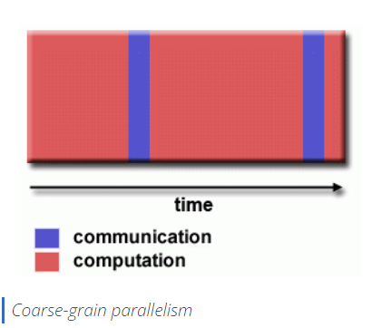
Coarse-grain Parallelism
Relatively large amounts of computational work are done between communication/synchronization events
High computation to communication ratio
Implies more opportunity for performance increase
Harder to load balance efficiently

Slide 33
Which is Best?
The most efficient granularity is dependent on the algorithm and the hardware environment in which it runs.
In most cases the overhead associated with communications and synchronization is high relative to execution speed so it is advantageous to have coarse granularity.
Fine-grain parallelism can help reduce overheads due to load imbalance.

Slide 34
I/O
I/O operations are generally regarded as inhibitors to parallelism.
I/O operations require orders of magnitude more time than memory operations.
Parallel I/O systems may be immature or not available for all platforms.
In an environment where all tasks see the same file space, write operations can result in file overwriting.
Read operations can be affected by the file server's ability to handle multiple read requests at the same time.
I/O that must be conducted over the network (NFS, non-local) can cause severe bottlenecks and even crash file servers.

Slide 35
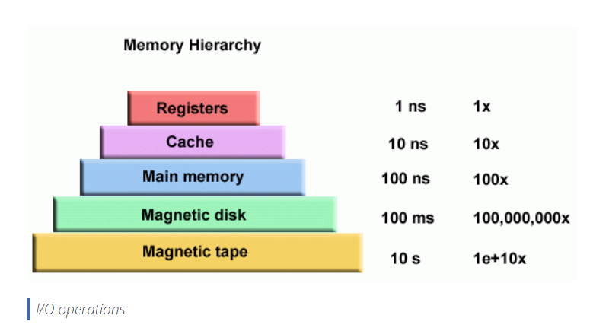

Slide 36
Parallel file systems are available.
For example:
GPFS: General Parallel File System (IBM). Now called IBM Spectrum Scale.
Lustre: for Linux clusters (Intel)
HDFS: Hadoop Distributed File System (Apache)
PanFS: Panasas ActiveScale File System for Linux clusters (Panasas, Inc.)

Slide 37
Debugging
Debugging parallel codes can be incredibly difficult, particularly as codes scale upwards.
The good news is that there are some excellent debuggers available to assist:
  Threaded - pthreads and OpenMP
  MPI
  GPU / accelerator
  Hybrid
Livermore Computing users have access to several parallel debugging tools installed on LC's clusters:
  TotalView from RogueWave Software
  DDT from Allinea
  Inspector from Intel
  Stack Trace Analysis Tool (STAT) - locally developed at LLNL
All of these tools have a learning curve associated with them.

Slide 38
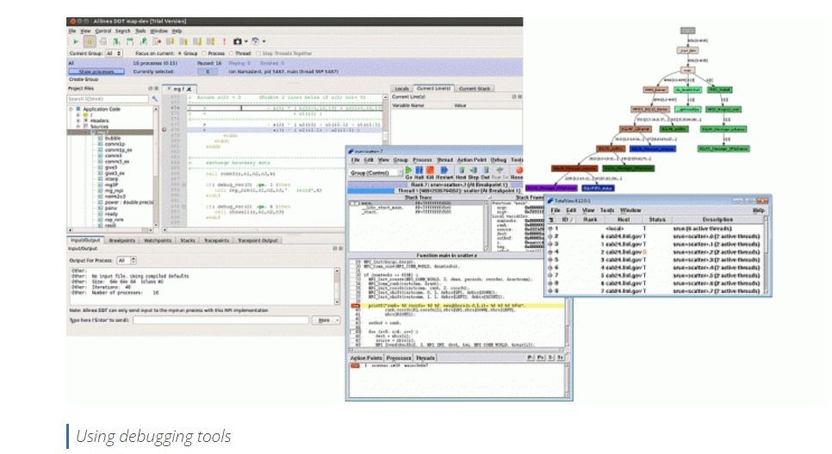

Slide 39
Performance Analysis and Tuning
As with debugging, analyzing and tuning parallel program performance can be much more challenging than for serial programs.
Fortunately, there are a number of excellent tools for parallel program performance analysis and tuning.
Livermore Computing users have access to several such tools, most of which are available on all production clusters.

Slide 40
Parallel Examples
This example demonstrates calculations on 2-dimensional array elements; a function is evaluated on each array element.
The computation on each array element is independent from other array elements.
The problem is computationally intensive.
The serial program calculates one element at a time in sequential order.
Serial code could be of the form:

